Slide 1
Greenassets.in
The ADOPT CSR Program

Slide 2
Contents
About Greenassets.in
Why invest in CSR?
The Greenassets.in ADOPT program - why choose it?
ADOPT program: Benefits and Returns
Technical & Program Tie-ups
CSR Implementation Framework
CSR Investments

Slide 3
About Greenassets.in
Greenassets.in promotes clean energy, waste management and eco friendly products.
We are a partnership startup based out of Dehradun, Uttarakhand since inception in 2014.
We have worked on a few impactful projects such as: SolarMills for Forest Department (Govt. of Uttarakhand), Solar Installations at Ganga Maki Handloom Unit , Waste Management solutions at Wynberg Allen School, Hotel Madhuban in Dehradun, St. Georges Mussoorie.
We are in talks with leading foundations and NGO’s in helping them provide social infrastructure via clean energy & waste management programs to local communities and villages.

Slide 4
Why invest in CSR
Opportunity to show consumers a brands human face.
Better reputation management with internal and external stakeholders.
Create a unique value proposition with advocates.
Create positive impact & word of mouth.
Create visible brand salience that has a longer shelf life than other marketing initiatives.

Slide 5
The Indian CSR clause requires 2% of profit spending on these government approved development areas:
Eradicating extreme hunger and poverty;
Promotion of education;
Promoting gender equality and empowering women;
Reducing child mortality and improving maternal health;
Combating HIV, AIDS, malaria and other diseases;
Ensuring environmental sustainability;
Employment-enhancing vocational skills;
Social business projects;
Contribution to the Prime Minister’s National Relief Fund or any other fund set up by the Central Government.

Slide 6
Greenassets.in CSR Vision
Proactively contributing towards Prime Minister Narendra Modi’s 2022 Renewable Energy Development plan and Swachh Bharat Mission.
Maximize Social Impact through targeting displaced and poor communities.
Maximize Environmental Impact through use of renewable energy.
Provide energy security to ’last mile villages’ through use of decentralized solutions to accelerate development.
Improve health and combat diseases through effective waste management systems.

Slide 7
Greenassets.in CSR Benefits
Our ties with renewable energy providers & NGOs working in Uttarakhand and North India make it easier to identify beneficiaries where your funds would create real impact.
From beneficiary identification to reliable system design and project commissioning, we ensure that your CSR initiatives create the value they intend to.
Greenassets.in does end to end CSR implementation that ranges from idea conceptualization, budget allocation, identification of villages/institutions to project implementation & delivery.

Slide 8
The Greenassets.in ADOPT Program

Slide 9
The Greenassets.in unique 4 tier ADOPT program allows responsible corporates to -
ADOPT a Village
Complete social infrastructure programs starting as low as INR 4,99,990.
ADOPT an Institution
Make a difference for as low as INR 1,49,998
ADOPT a Home
Change a families future for as little as INR 24,898
ADOPT the Underprivileged
Empower a life for as low as INR 499
The ultimate aim of the four tier Greenasset.in ADOPT program is to provide clean energy, waste management solutions and security to rural and underserved communities and individuals in order to empower them and have a positive impact on their lives.

Slide 10
PROGRAM BENEFITS & RETURNS

Slide 11
ADOPT a Village - Where Greenassets.in will help identify a rural village which requires social infrastructure and will execute an end to end CSR project for you.
Greenassets.in annual maintenance included
MNRE/UREDA certification
Feature in Greenassets.in bimonthly newsletter
2 Facebook Paid Ads highlighting the initiative
Emailer mentions to Greenassets.in communities and databases on social media
Impact Data on your impact investments
Carbon footprint reduction report
Energy generation data.

Slide 12
ADOPT an Institution – Where Greenassets.in will help identify & partner with underprivileged institutions and accelerate their all round growth and development.
Annual Greenassets.in project maintenance included
Feature in Greenassets.in newsletters
Emailer mentions to Greenassets.in communities and databases on social media
Impact Data on your impact investments
Energy generation data.

Slide 13
ADOPT the Underprivileged – Where Greenassets.in will give individual eco-friendly products to the less privileged children and women in order to enable them to have a productive & safe future.
Details of the Beneficiaries
Feature in Greenassets.in newsletters
Emailer mentions to Greenassets.in communities and databases on social media

Slide 14
TECHNICAL PARTNERSHIPS

Slide 15
Greenassets.in ADOPT programs are deployed in partnership with market leading manufacturers across renewable energy and waste management technologies.
Clean Energy Waste Management Eco- Friendly

Slide 16
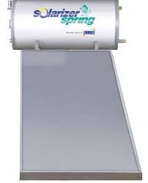
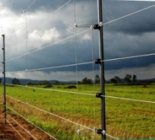
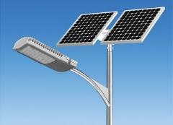
Clean Energy Solutions
Solar mills by Windstream Technologies
Solarizer Solar Water Heaters
VB Solar Security Fencing
Glightz Integrated Solar Lights
EMMVEE & Solon Solar PV Panels
Unitron Energy Small Wind Turbines

Slide 17
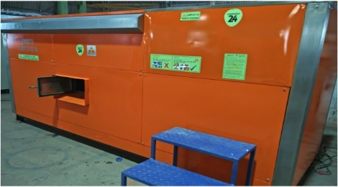
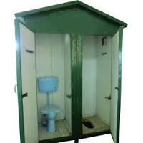
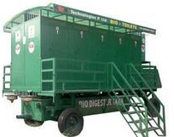
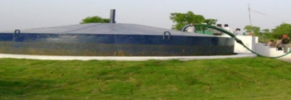
Waste Management Solutions
Organic Waste Composting Machines
DRDO designed Bio Toilets
Low Cost Twin Pit Toilets
Bio-methanation Sewage Power Plant

Slide 18
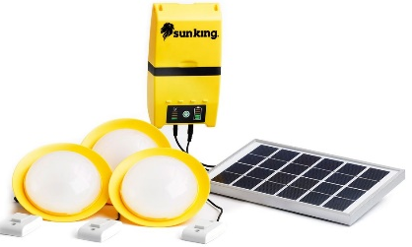
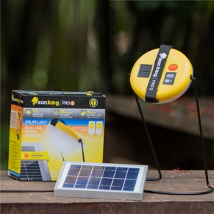
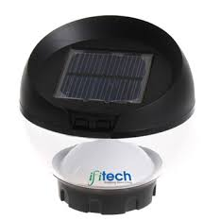
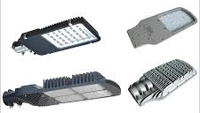
Eco Friendly Products
Sunking Home 120
Sunking Home 60
Sunking All Night with Mobile Charger
Sinking Pro 2 with dual Mobile Charger
Sunking Pico
Ifitech Solar Security Lamps
Glightz LED Lights

Slide 19
PROGRAM PARTNERSHIPS

Slide 20
Greenassets.in has partnerships with the following NGO’s, Govt. Institutions & Foundations:
Aasra Trust www.aasraatrust.org
Eshitas Welfare Foundation www.eshita.org
The Hans Foundation www.thehansfoundation.org
Forest Research Institute www.fri.icfre.gov.in
UDAI Foundation www.udaifoundation.org
Nagar Nigams of Dehradun, Kashipur, Roorkee, Haldwani, Bageshwar, Haridwar and other towns in Uttarakhand
Gram Panchayats and ‘Van’ Panchayats of ‘last mile villages’ across Uttarakhand

Slide 21
CSR FRAMEWORK

Slide 23
ADOPT INVESTMENTS

Slide 24
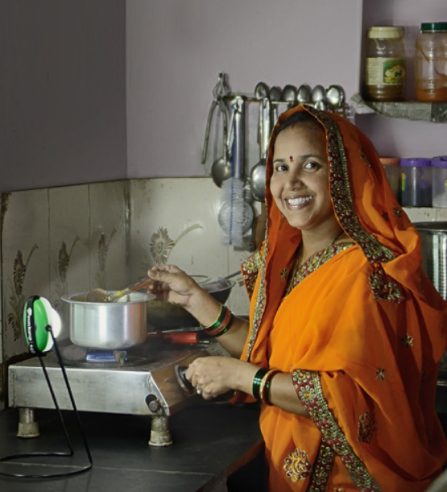
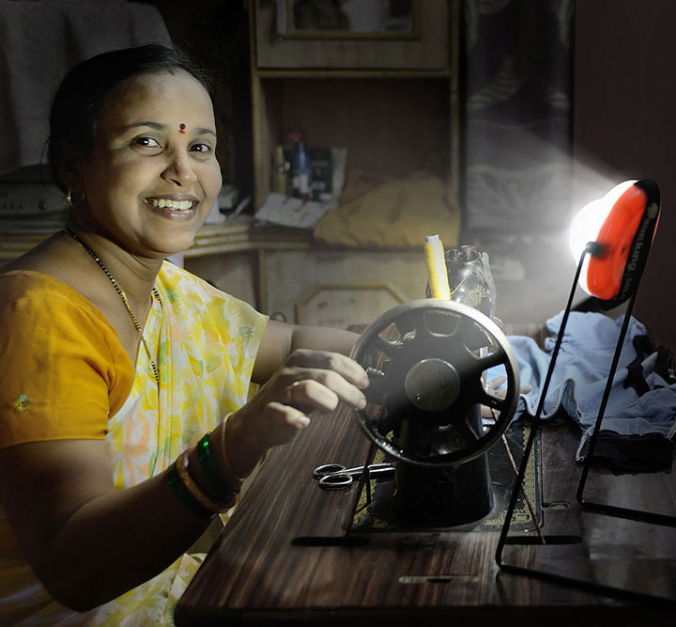
GREENASSETS.IN CSR PROJECT – ADOPT AN UNDERPRIVILEDGED
Brighten the life of a poor child or woman by providing them a Sunking Pico Solar Lamp with a 2 year replacement warranty for Rs.499/- per person
OR
Provide a brighter Sunking All Night portable study lamp with USB charger for Rs.1,899/- per person

Slide 25
GREENASSETS.IN CSR PROJECT – ADOPT A HOME
Provide clean energy and a clean environment to a family
S.NO. | PRODUCTS |  |  |  |  | QUANTITY |  |  | MRP
1 | SUNKING ALL NIGHT SOLAR LANTERN |  |  |  |  | 1 |  |  | 1,899/-
2 | SUNKING HOME 120 (3 LIGHT + MOBILE CHARGER SOLAR SYSTEM) |  |  |  |  | 1 |  |  | 6,999/-
3 | LOW COST TOILET |  |  |  |  | 1 |  |  | 16,000/-
 | TOTAL |  |  |  |  |  |  |  | 24,898 per home

Slide 26
GREENASSETS.IN CSR PROJECT – ADOPT AN INSTITUTION
Provide clean energy and waste management facilities to an underdeveloped institution
S.NO. | PRODUCTS |  |  |  |  |  |  | QUANTITY |  | COST
1 | SUNKING HOME 120 |  |  |  |  |  |  | 2 |  | 13,998
2 | SMART BIN |  |  |  |  |  |  | 3 |  | 6,600
3 | SOLAR LED STREET LIGHT (12W) |  |  |  |  |  |  | 2 |  | 40,000
4 | LOW COST TOILET |  |  |  |  |  |  | 4 |  | 66,000
5 | INSTALLATION AND ANNUAL MAINTAINENCE |  |  |  |  |  |  |  |  | 23,400
 | TOTAL |  |  |  |  |  |  |  |  | 1,49,998/-

Slide 27
GREENASSETS.IN CSR PROJECT – ADOPT A VILLAGE
INTEGRATED SOLUTION 1
S.NO. | PRODUCTS |  |  |  |  |  |  | QUANTITY |  | COST
1 | INTEGRATED SOLAR LED STREET LIGHTS (32 W) WITH 5 MTR. POLES |  |  |  |  |  |  | 10 |  | 3,10,000
2 | LOW COST TOILETS (FRP CABIN +IC + MARBLE FLOOR + FITTINGS + SOLAR LIGHT + TWIN PIT) |  |  |  |  |  |  | 4 |  | 86,000
3 | SMARTBINS FOR ORGANIC WASTE DISPOSAL |  |  |  |  |  |  | 20 |  | 52,000
4 | COLLECTION DRUMS FOR RECYCLABLE WASTE |  |  |  |  |  |  | 4 |  | 10,000
5 | INSTALLATION AND ANNUAL MAINITAINENCE |  |  |  |  |  |  |  |  | 41,990
 | TOTAL |  |  |  |  |  |  |  |  | 4,99,990/-
Suitable for a village / hamlet having 25 – 50 homes with around 150-200 residents. We can also deliver customized solutions for larger villages of up to 500 homes.

Slide 28
GREENASSETS.IN CSR PROJECT – ADOPT A VILLAGE
INTEGRATED SOLUTION 2
S.NO. | PRODUCTS |  |  | QUANTITY | MRP
1 | SOLAR PV PANELS SYSYTEM (6KW)
 | 1 | SOLAR PANEL FORM EMMVEE (250 W ) |  | 24 | 432,000
 | 2 | BATTERY BANK (48V, 600Ah) |  | 1 | 200,000
 | 3 | INVERTER (6.25 KW) |  | 1 | 300,000
 | 4 | WIRES AND OTHER ACCESSORIES |  | 1 | 30,000
 | 5 | INSTALLATION |  |  | 22,600
 | 6 | CONSULTING CHARGES (Include 1 year annual maintenance) |  |  | 25,400
2 | SMART BINS |  |  | 100 | 180,000
3 | INTEGRATED SOLAR STREET LIGHHT (12W)
 | 1 | ALL IN ONE STREET LIGHT |  | 20 | 420,000
 | 2 | METAL POLE (7M) |  | 20 | 60,000
 | 3 | INSTALLATION AND ANNUAL MAINTENANCE |  |  | 15,000
4 | BIO-TOILET
 | 1 | DIGESTER TANK (10000 LT) (BFE-200) |  | 1 | 472,000
 | 2 | PRE FABRICATED CABIN WITH 10 SEATER |  | 1 | 327,600
 | 3 | INSTALLATION AND ANNUAL MAINTENANCE |  |  | 15,400
 |  | TOTAL |  |  | 25,00,000

Slide 29
THANK YOU
Contact:
Romik Rai, Partner & CEO
+91-8954023000 | greenassets.in@gmail.com

